Slide 1

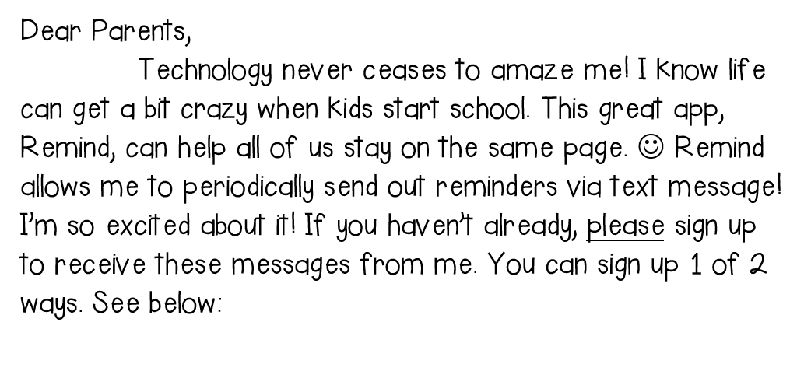

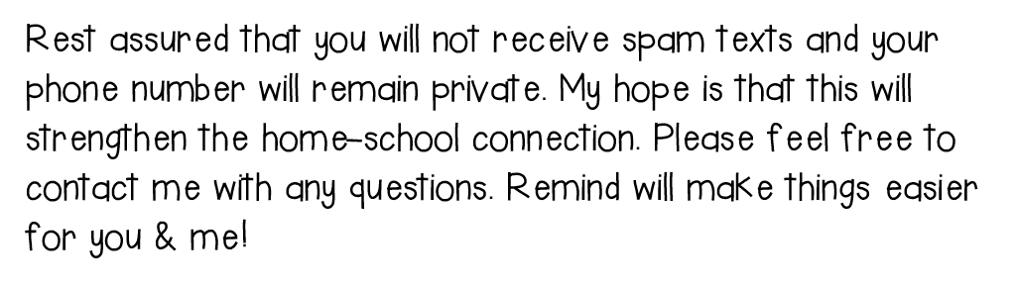
Download the free Remind app and enter in this class code.
@fettermank
Send a text to 81010 with the message
@fettermank

